Slide 1

Sink or Swim
a game by Natasha Belshaw

Slide 2
Summary
Engine:
Unity
Art Style:
2D
Premise:
You play as a large fish, swimming through the ocean. Your goal is to get the highest score possible. Points are gained by eating smaller fish or worms, and lost by eating trash. Points are tallied on the screen. If your points go below zero or if you collide with a shark, the game ends.

Slide 3
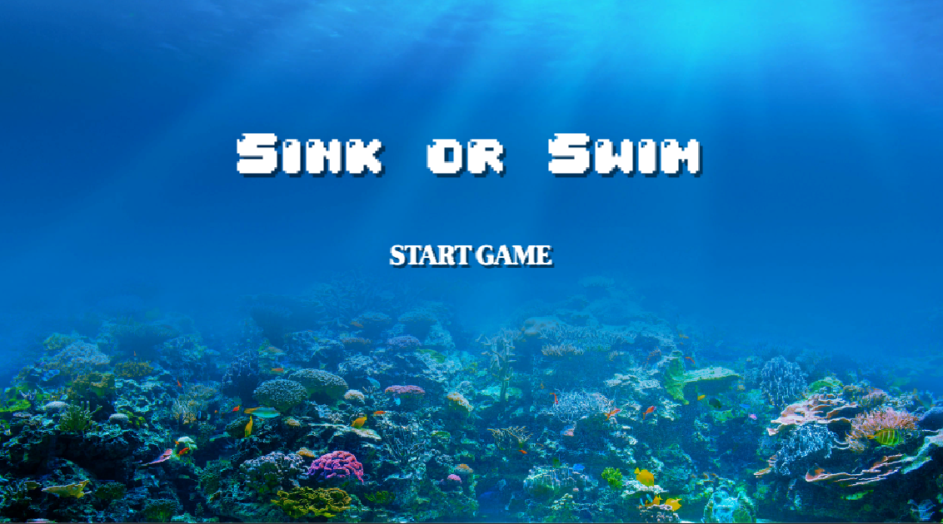
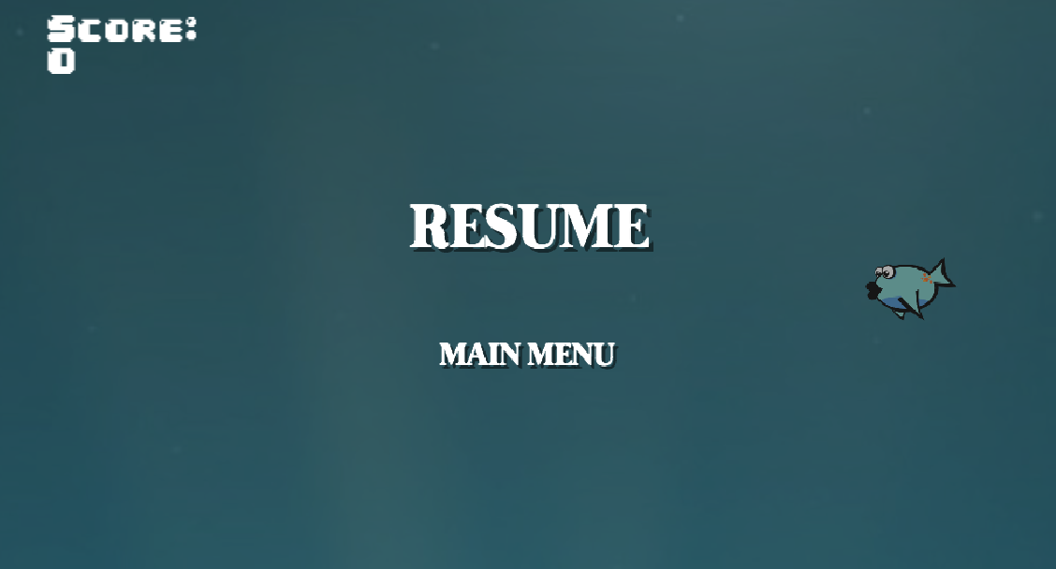
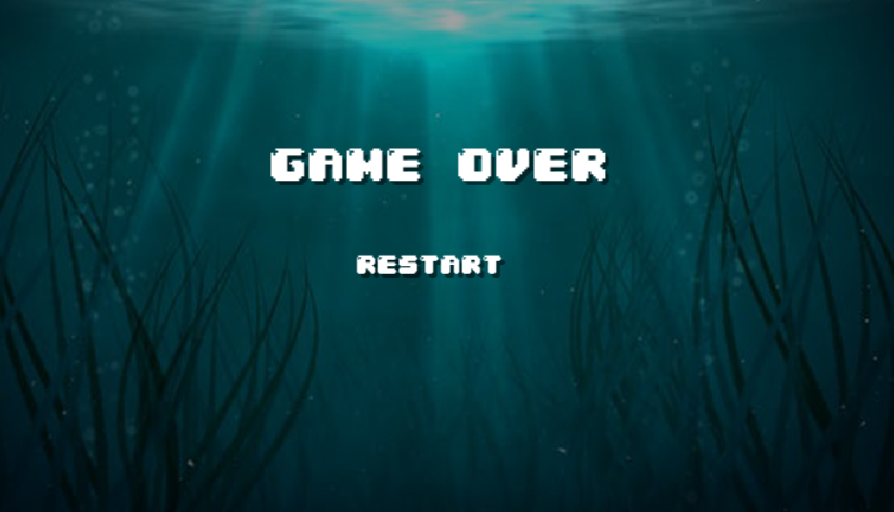
Game Components
Scrolling background
Main Menu
Title and Start Game button
Pause Menu (press esc to access during game)
Resume or go to the main menu
Game Over Screen
Restart game button
(all buttons get darker when you hover over them and click on them)

Slide 4
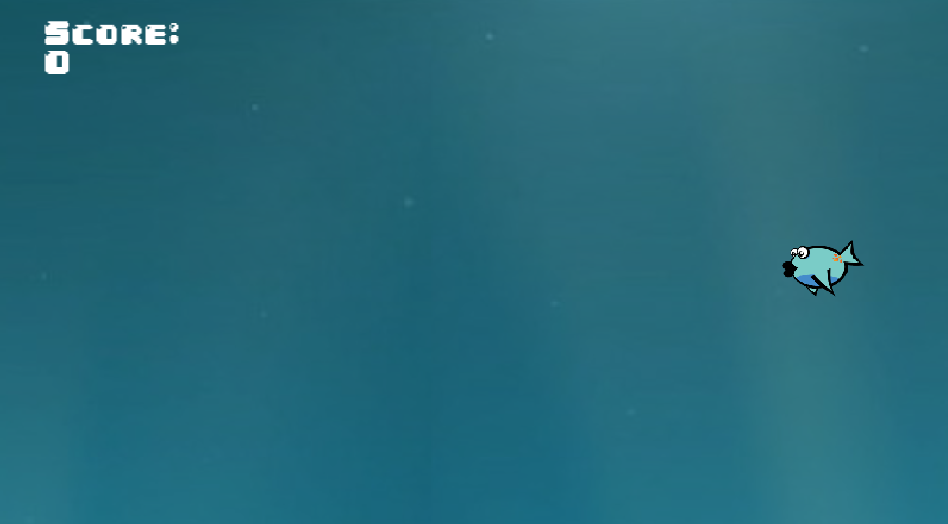
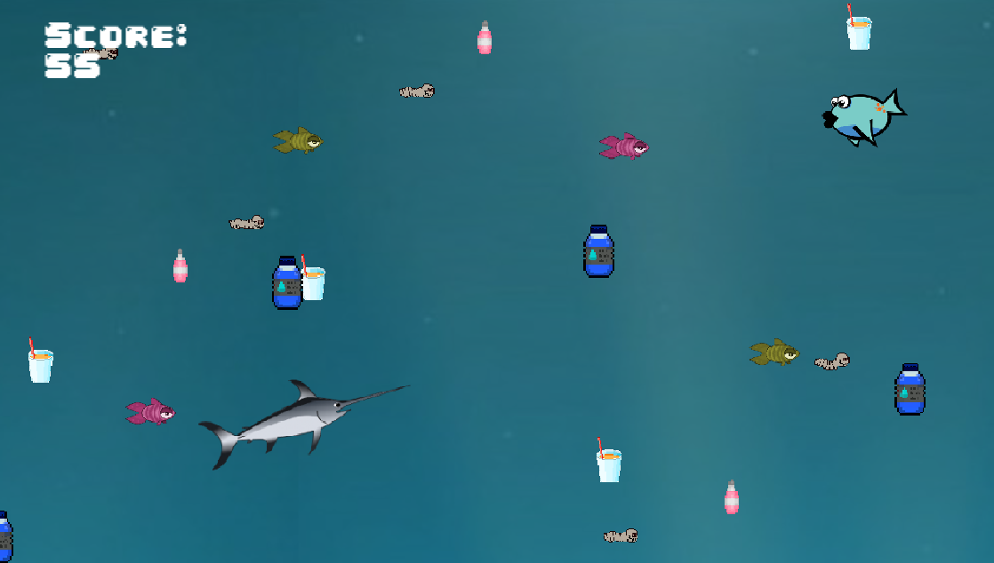
Game Features
Move the player up and down with arrow keys
Player’s x axis position is static
Items don’t enter for the first 10 seconds to allow the user to get accustomed to controls
When you collide with...
Worms: +5 points
Fish: +10 points
Trash: -10 points
Sharks: Game Over
If your score goes below zero, the game also ends

Slide 5
Resources
All images are from opengameart.org
Main fish
https://opengameart.org/content/aqua-fish
Smaller fish
https://opengameart.org/content/colored-fish
Worms
https://opengameart.org/content/skyll-floating-skull-worm
Trash
https://opengameart.org/content/drink-icon-pack
Swordfish
https://opengameart.org/content/xiphias-gladius-svg
Fonts
https://www.dafont.com/bitmap.php
https://www.dafont.com/theme.php?cat=502

Slide 6
Thank you!

